Slide 1
Module 2: Securing Networks
Instructor Materials
Cybersecurity Essentials 3.0
Notes:
Cybersecurity Essentials 3.0
Module 2: Securing Networks

Slide 2
Instructor Materials – Module 2 Planning Guide
This PowerPoint deck is divided into two parts:
Instructor Planning Guide
  Information to help you become familiar with the module
  Teaching aids
Instructor Class Presentation
  Optional slides that you can use in the classroom
  Begins on slide # 8
  Note: Remove the Planning Guide from this presentation before sharing it with anyone.

Slide 3
What to Expect in this Module
To facilitate learning, the following features within the UI may be included in this module:
Feature | Description
Avatar | A virtual character, representing a subject matter expert, adds additional contextual information to skills the students have learned and helps them connect the dots by asking honest reflection questions.
Animations | Expose learners to new skills and concepts.
Videos | Expose learners to new skills and concepts.
Check Your Understanding | Per topic online quiz to help learners gauge content understanding.
Interactive Activities | A variety of formats to help learners gauge content understanding.
Syntax Checker | Small simulations expose learners to the Cisco command line to practice configuration skills.
PT Activity | Simulation and modeling activities are designed to explore, acquire, reinforce, and expand skills.

Slide 4
What to Expect in this Module (Cont.)
To facilitate learning, the following features within the UI may be included in this module:
Feature | Description
Hands-On Labs | Labs designed for working with physical equipment.
Module Quizzes | Self-assessments that integrate concepts and skills learned throughout the series of topics presented in the module.
Module Summary | Briefly recaps module content.

Slide 5
Check Your Understanding
Check Your Understanding activities are designed to let students quickly determine if they understand the content and can proceed or if they need to review.
Check Your Understanding activities do not affect student grades.
There are no separate slides for these activities in the PPT. They are listed in the notes area of the slide that appears before these activities.

Slide 6
Module 2: Activities
What activities are associated with this module?
Page # | Activity | Activity Name | Optional?
2.1.1 | Video | Video - Anatomy of an Attack | Recommended
2.1.6 | Video | PT Video - Investigate a Threat Landscape | Recommended
2.1.7 | PT Activity | Packet Tracer - Investigate a Threat Landscape | Recommended
2.2.8 | Check Your Understanding | Check Your Understanding - What Color is my Hat? | Recommended
Activity Wizard Password: PT_csp11

Slide 7
Module 2: Best Practices
Before teaching Module 2, the instructor should:
Review the activities and assessments for this module.
Try to include as many questions as possible to keep students engaged during classroom presentations.
Topic 2.1
  Open a web browser, visit https://cybermap.Kaspersky.com/, explore MAP, and ask students to choose different countries. If time allows, show the Statistics
  Discuss in the class:
    What are the reasons for network security?
    While covering 2.1.5, ask students to think about what damages are caused by data loss.

Slide 8
Module 2: Securing Networks
Cybersecurity Essentials 3.0
Notes:
Cybersecurity Essentials 3.0
Module 2: Securing Networks

Slide 9
Module Objectives
Module Title: Securing Networks
Module Objective: Explain network security principles.
Topic Title | Topic Objective
Current State of Affairs | Explain the threats, vulnerabilities, and attacks that occur in the various domains.
Who is Attacking Our Network? | Explain how network threats have evolved.

Slide 10
2.1 Current State of Affairs
Notes:
2: Securing Networks
2.1: Current State of Affairs

Slide 11
Current State of Affairs
Video - Anatomy of an Attack
This video shows a sampling of what cybersecurity professionals do. Cisco Security Architect, Matt Carling, offers the defender's point of view and why a "Defense in Depth" layer approach is best.
Notes:
2: Securing Networks
2.1: Current State of Affairs
2.1.1: Video - Anatomy of an Attack

Slide 12
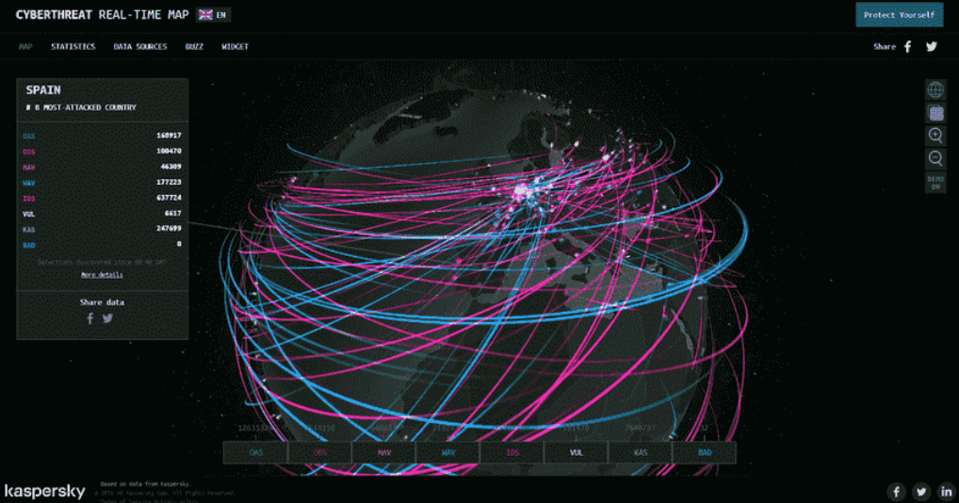
Current State of Affairs
Networks Are Targets
Computer networks are routinely under attack.
Kapersky maintains the interactive Cyberthreat Real-Time Map display of current network attacks.
The attack data is submitted from Kapersky network security products deployed worldwide.
Many similar tools are available on the internet and can be found by searching for cyber threat maps.
Notes:
2: Securing Networks
2.1: Current State of Affairs
2.1.2: Networks Are Targets

Slide 13
Current State of Affairs
Reasons for Network Security
Network security relates directly to the business continuity of an organization.
Network security breaches can disrupt e-commerce, cause the loss of business data, threaten people’s privacy, and compromise the integrity of information.
These breaches can result in lost revenue for corporations, theft of intellectual property, lawsuits, and even threaten public safety.
Maintaining a secure network ensures the safety of network users and protects commercial interests.
Keeping a network secure requires vigilance from an organization’s network security professionals.
Many tools help network administrators adapt, develop, and implement threat mitigation techniques. Two examples are:
  Cisco Talos Intelligence Group website
  Cisco Product Security Incident Response Team (PSIRT)
Notes:
2: Securing Networks
2.1: Current State of Affairs
2.1.3: Reasons for Network Security

Slide 14
Current State of Affairs
Vectors of Network Attacks
An attack vector is a path by which a threat actor can access a server, host, or network.
Attack vectors originate from inside or outside the corporate network.
  An internal user, such as an employee, can accidentally or intentionally:
    Steal and copy confidential data to removable media, email, messaging software, and other media.
    Compromise internal servers or network infrastructure devices.
    Disconnect a critical network connection and cause a network outage.
    Connect an infected USB drive to a corporate computer system.
  Internal threats have the potential to cause more significant damage than external threats.
Network security professionals must implement tools and apply techniques to mitigate external and internal threats.
Notes:
2: Securing Networks
2.1: Current State of Affairs
2.1.4: Vectors of Network Attacks

Slide 15
Current State of Affairs
Data Loss
Term | Definition
Email/Social Networking | The most common vector for data loss includes instant messaging software and social media sites. For instance, intercepted email or IM messages could be captured and reveal confidential information.
Unencrypted Devices | A stolen corporate laptop typically contains confidential organizational data. The thief can retrieve valuable personal data if the data is not stored using an encryption algorithm.
Cloud Storage Devices | Saving data to the cloud has many potential benefits. However, sensitive data can be lost if access to the cloud is compromised due to weak security settings.
Removable Media | One risk is that an employee could perform an unauthorized transfer of data to a USB drive. Another chance is that a USB drive containing valuable corporate data could be lost.
Hard Copy | Corporate data should be disposed of thoroughly. For example, confidential data should be shredded when no longer required. Otherwise, a thief could retrieve discarded reports and gain valuable information.
Improper Access Control | Passwords are the first line of defense. Stolen passwords or weak passwords which have been compromised can provide an attacker easy access to corporate data.
Notes:
2: Securing Networks
2.1: Current State of Affairs
2.1.5: Data Loss

Slide 16
Current State of Affairs
Packet Tracer - Investigate a Threat Landscape
In this Packet Tracer activity, you will meet the following objectives:
  Part 1: Investigate the Bottom Toolbar
  Part 2: Investigate Devices in a Wiring Closet
  Part 3: Connect End Devices to Networking Devices
  Part 4: Install a Backup Router
  Part 5: Configure a Hostname
  Part 6: Explore the Rest of the Network
Notes:
2: Securing Networks
2.1: Current State of Affairs
2.1.6: PT Video – Investigate a Threat Landscape
2.1.7: Packet Tracer - Investigate a Threat Landscape

Slide 17
2.2 Who is Attacking Our Network?
Notes:
2: Securing Networks
2.2: Who is Attacking Our Network?

Slide 18
Who is Attacking Our Network?
Threat, Vulnerability, and Risk
We are under attack and attackers want access to our assets (data, intellectual property, servers, computers, smart phones, tablets, and more).
Term | Explanation
Threat | A potential danger to an asset such as data or the network itself.
Vulnerability | A weakness in a system or its design that a threat could exploit.
Attack surface | An attack surface is the total sum of the vulnerabilities in a given system that is accessible to an attacker. The attack surface describes different points where an attacker could get into a plan and where they could get data out of the system.
Exploit | The mechanism that is used to leverage a vulnerability to compromise an asset. Exploits may be remote or local. A remote exploit works over the network without prior access to the target system. The attacker does not need an account in the end system to exploit the vulnerability. In a local exploit, the threat actor has some user or administrative access to the end system. A local exploit does not necessarily mean the attacker has physical access to the end system.
Risk | The likelihood that a particular threat will exploit a specific vulnerability of an asset and result in an undesirable consequence.
Notes:
2: Securing Networks
2.2: Who is Attacking Our Network?
2.2.1: Threat, Vulnerability, and Risk

Slide 19
Who is Attacking Our Network?
Threat, Vulnerability, and Risk (Cont.)
There are four common ways to manage risk:
Risk Management Strategy | Explanation
Risk acceptance | This is when the cost of risk management options outweighs the cost of the risk itself. The risk is accepted, and no action is taken.
Risk avoidance | This means avoiding any exposure to the risk by eliminating the activity or device that presents the danger. Removing an activity to prevent risk, and any possible benefits from the training are also lost.
Risk reduction | This reduces exposure to risk or the impact of risk by taking action to decrease the risk. It is the most commonly used risk mitigation strategy. This strategy requires careful evaluation of the costs of loss, the mitigation strategy, and the benefits gained from the operation or activity at risk.
Risk transfer | Some or all of the risk is transferred to a willing third party, such as an insurance company.
Notes:
2: Securing Networks
2.2: Who is Attacking Our Network?
2.2.1: Threat, Vulnerability, and Risk
2.2.1: Threat, Vulnerability, and Risk (Cont.)

Slide 20
Who is Attacking Our Network?
Hacker vs. Threat Actor
The term “hacker” has a variety of meanings:
  A clever programmer capable of developing new programs and coding changes to existing programs to make them more efficient.
  A network professional that uses sophisticated programming skills to ensure that networks are not vulnerable to attack.
  A person who tries to gain unauthorized access to devices on the internet.
  An individual who run programs to prevent or slow network access to many users, or corrupt or wipe out data on servers.
An attack vector is a path by which a threat actor can gain access to a server, host, or network.
Notes:
2: Securing Networks
2.2: Who is Attacking Our Network?
2.2.2: Hacker vs. Threat Actor

Slide 21
Who is Attacking Our Network?
Hacker vs. Threat Actor (Cont.)
White hat hacker, black hat hacker, and grey hat hacker:
White hat hackers are ethical hackers who use their programming skills for good, ethical, and legal purposes. They may perform network penetration tests in an attempt to compromise networks and systems by using their knowledge of computer security systems to discover network vulnerabilities.
Grey hat hackers are individuals who commit crimes and do arguably unethical things, but not for personal gain or to cause damage. An example would be someone who compromises a network without permission and then discloses the vulnerability publicly.
Black hat hackers are unethical criminals who violate computer and network security for personal gain or for malicious reasons, such as attacking networks. Black hat hackers exploit vulnerabilities to compromise computer and network systems.
Notes:
2: Securing Networks
2.2: Who is Attacking Our Network?
2.2.2: Hacker vs. Threat Actor (Cont.)

Slide 22
Who is Attacking Our Network?
Evolution of Threat Actors
Threat Actors | Explanation
Script kiddies | Script kiddies emerged in the 1990s and refer to teenagers or inexperienced threat actors running existing scripts, tools, and exploits to cause harm, but typically not for profit.
Vulnerability brokers | Vulnerability brokers typically refer to grey hat hackers who attempt to discover exploits and report them to vendors, sometimes for prizes or rewards.
Hacktivists | Hacktivists is a term that refers to grey hat hackers who rally and protest against different political and social ideas. Hacktivists publicly protest against organizations or governments by posting articles, and videos, leaking sensitive information and performing distributed denial of service (DDoS) attacks.
Cybercriminals | Cybercriminal is a term for black hat hackers who are self-employed or working for large cybercrime organizations. Cybercriminals steal billions of dollars from consumers and businesses each year.
State-sponsored | State-Sponsored hackers are threat actors who steal government secrets, gather intelligence, and sabotage networks of foreign governments, terrorist groups, and corporations. Most countries in the world participate to some degree in state-sponsored hacking. Depending on a person’s perspective, these are either white or black hat hackers.
Notes:
2: Securing Networks
2.2: Who is Attacking Our Network?
2.2.3: Evolution of Threat Actors

Slide 23
Who is Attacking Our Network?
Cybercriminals
  Cybercriminals are threat actors motivated to make money using any means necessary.
  While sometimes cybercriminals work independently, they are more often financed and sponsored by criminal organizations.
  Cybercriminals operate in an underground economy where they buy, sell, and trade exploits and tools.
  They also buy and sell the personal information and intellectual property they steal from victims.
  Cybercriminals target small businesses, consumers, and large enterprises and industries.
Notes:
2: Securing Networks
2.2: Who is Attacking Our Network?
2.2.4: Cybercriminals

Slide 24
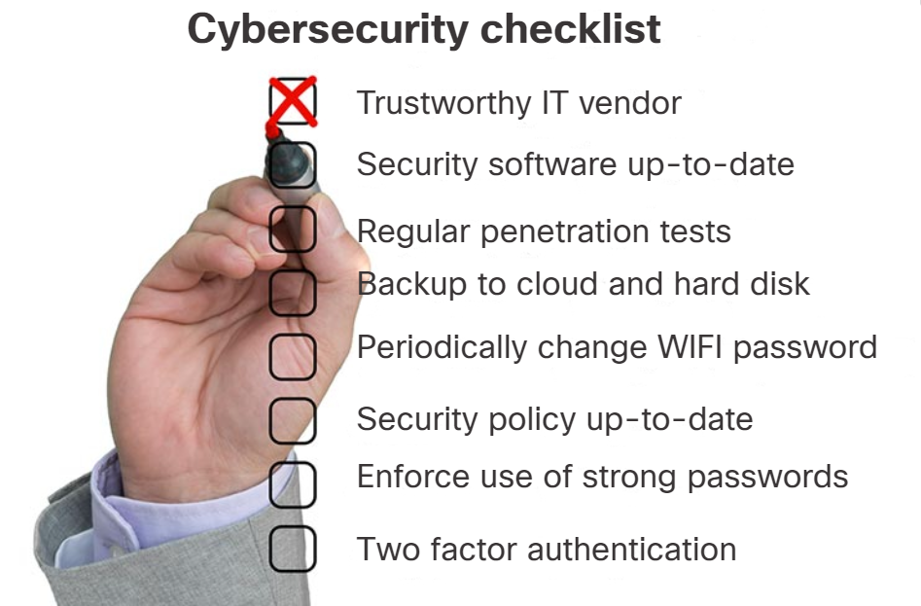
Who is Attacking Our Network?
Cybersecurity Tasks
Threat actors target the vulnerable end devices of home users, small-to-medium-sized businesses, and large public and private organizations.
To make the internet and networks safer and more secure, we must develop good cybersecurity awareness.
Cybersecurity is a shared responsibility that all users must practice.
Organizations must take action and protect their assets, users, and customers. They must develop and practice cybersecurity tasks like those listed in the figure.
Notes:
2: Securing Networks
2.2: Who is Attacking Our Network?
2.2.5: Cybersecurity Tasks

Slide 25
Who is Attacking Our Network?
Cyber Threat Indicators
Many network attacks can be prevented by sharing information about indicators of compromise (IOC).
IOCs can be features that identify malware files, IP addresses of servers used in attacks, filenames, and characteristic changes made to end system software, among others.
IOCs help cybersecurity personnel identify what has happened in an attack and develop defenses against the attack.
Indicators of attack (IOA) focus more on the motivation behind an attack and the potential means by which threat actors have, or will, compromise vulnerabilities to gain access to assets.
IOAs are concerned with the strategies that attackers use. For this reason, IOAs can help generate a proactive security approach rather than responding to a single threat.
Defending against a strategy can prevent future attacks that utilize the same or similar strategy.
Notes:
2: Securing Networks
2.2: Who is Attacking Our Network?
2.2.6: Cyber Threat Indicators

Slide 26
Who is Attacking Our Network?
Threat Sharing and Building Cybersecurity Awareness
Governments are now actively promoting cybersecurity. The US Cybersecurity Infrastructure and Security Agency (CISA) is leading efforts to automate cybersecurity information sharing with public and private organizations at no cost.
CISA uses a system called Automated Indicator Sharing (AIS). AIS enables the sharing of attack indicators between the US government and the private sector as soon as threats are verified.
The CISA and the National Cyber Security Alliance (NCSA) promote cybersecurity to all users.
The CISA and NCSA have an annual October campaign called “National Cybersecurity Awareness Month” (NCASM). This campaign promotes and raises awareness about cybersecurity.
Notes:
2: Securing Networks
2.2: Who is Attacking Our Network?
2.2.7: Threat Sharing and Building Cybersecurity Awareness

Slide 27
Who is Attacking Our Network?
Threat Sharing and Building Cybersecurity Awareness (Cont.)
The CISA and NCSA have an annual campaign every October called “National Cybersecurity Awareness Month” (NCASM). The campaign provides material on a wide variety of security topics, including:
  Social media safety
  Updating privacy settings
  Awareness of device app security
  Keeping software up-to-date
  Safe online shopping
  Wi-Fi safety
  Protecting customer data
Notes:
2: Securing Networks
2.2: Who is Attacking Our Network?
2.2.7: Threat Sharing and Building Cybersecurity Awareness (Cont.)
2.2.8: Check Your Understanding – What Color is my Hat?

Slide 28
2.3 Securing Networks Summary
Notes:
2: Securing Networks
2.3: Securing Networks Summary

Slide 29
Securing Networks Summary
What Did I Learn in this Module?
Network security relates directly to an organization's business continuity.
Network security breaches can disrupt e-commerce, cause the loss of business data, threaten people's privacy, and compromise the integrity of information.
Many tools, including the Cisco Talos Intelligence Group, are available to help network administrators adapt, develop, and implement threat mitigation techniques.
An attack vector is a path by which a threat actor can access a server, host, or network.
Risk management is the process that balances the operational costs of providing protective measures with the gains achieved by protecting the asset.
Hacker is a term used to describe a threat actor. Threat actors include script kiddies, vulnerability brokers, hacktivists, cybercriminals, and state-sponsored hackers.
Many network attacks can be prevented by sharing information about IOCs. Many governments are promoting cybersecurity. CISA and NCSA are examples of such organizations.
Notes:
2: Securing Networks
2.3: Securing Networks Summary
2.3.1: What Did I Learn in this Module?
2.3.2: Securing Networks Quiz

Slide 30
Module 2
New Terms and Commands
Cisco Talos Intelligence Group
Cisco Product Security Incident Response Team (PSIRT)
Attack vector
White hat hacker, Black hat hacker, and Grey hat hacker
Script kiddies, Vulnerability brokers, Hacktivists, Cybercriminals, and State-Sponsored hackers
US Cybersecurity Infrastructure and Security Agency (CISA)
Automated Indicator Sharing (AIS)
Indicators of attack (IOA)
The CISA and the National Cyber Security Alliance (NCSA)
The European Union Agency for Cybersecurity (ENISA)
Notes:
2: Securing Networks
2.3: Securing Networks Summary
New Terms and Commands

